Slide 1
Design of Digital Circuits Lecture 24: Virtual Memory II
Prof. Onur Mutlu
ETH Zurich
Spring 2020
28 May 2020

Slide 2
Readings
Virtual Memory
Required
H&H Chapter 8.4

Slide 3
Recall: Virtual Memory
Idea: Give the programmer the illusion of a large address space while having a small physical memory
So that the programmer does not worry about managing physical memory
Programmer can assume he/she has “infinite” amount of physical memory
Hardware and software cooperatively and automatically manage the physical memory space to provide the illusion
Illusion is maintained for each independent process

Slide 4
Recall: A System with Physical Memory Only
Examples:
most Cray machines
early PCs
many embedded systems
CPU’s load or store addresses used
directly to access memory
Memory
0:
Physical
Addresses
1:
CPU
N-1:
Notes:
Ask about what are the potential problems? (Size, segmentation, security)

Slide 5
A System with Virtual Memory (Page based)
Address Translation: The hardware converts virtual addresses into physical addresses via an OS-managed lookup table (page table)
Memory
0:
Page Table
1:
Virtual
Addresses
Physical
Addresses
0:
1:
CPU
P-1:
N-1:
Disk

Slide 6
Recall: Virtual Memory Definitions
Page size: amount of memory transferred from hard disk to DRAM at once
Address translation: determining the physical address from the virtual address
Page table: lookup table used to translate virtual addresses to physical addresses (and find where the associated data is)

Slide 7
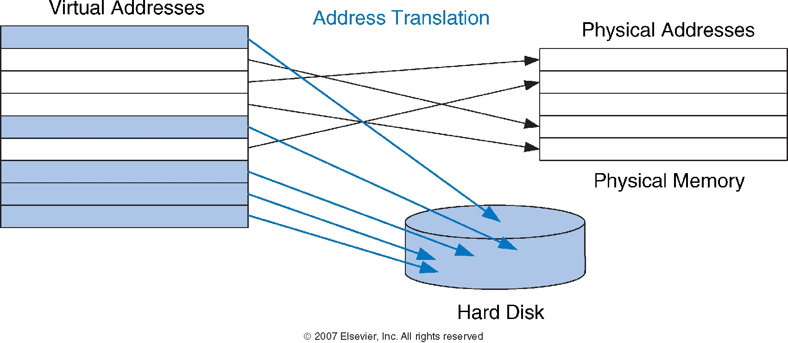
Recall: Virtual and Physical Addresses
Most accesses hit in physical memory
But programs see the large capacity of virtual memory
7

Slide 8
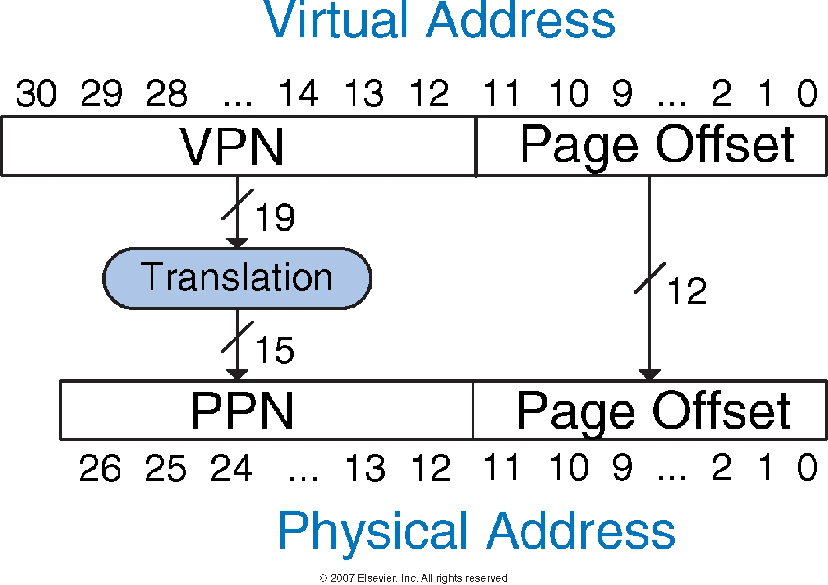
Recall: Address Translation

Slide 9
Recall: Virtual Memory Example
System:
Virtual memory size: 2 GB = 2³¹ bytes
Physical memory size: 128 MB = 2²⁷ bytes
Page size: 4 KB = 2¹² bytes

Slide 10
Recall: Virtual Memory Example
System:
Virtual memory size: 2 GB = 2³¹ bytes
Physical memory size: 128 MB = 2²⁷ bytes
Page size: 4 KB = 2¹² bytes
Organization:
Virtual address: 31 bits
Physical address: 27 bits
Page offset: 12 bits
# Virtual pages = 2³¹/2¹² = 2¹⁹ (VPN = 19 bits)
# Physical pages = 2²⁷/2¹² = 2¹⁵ (PPN = 15 bits)

Slide 11
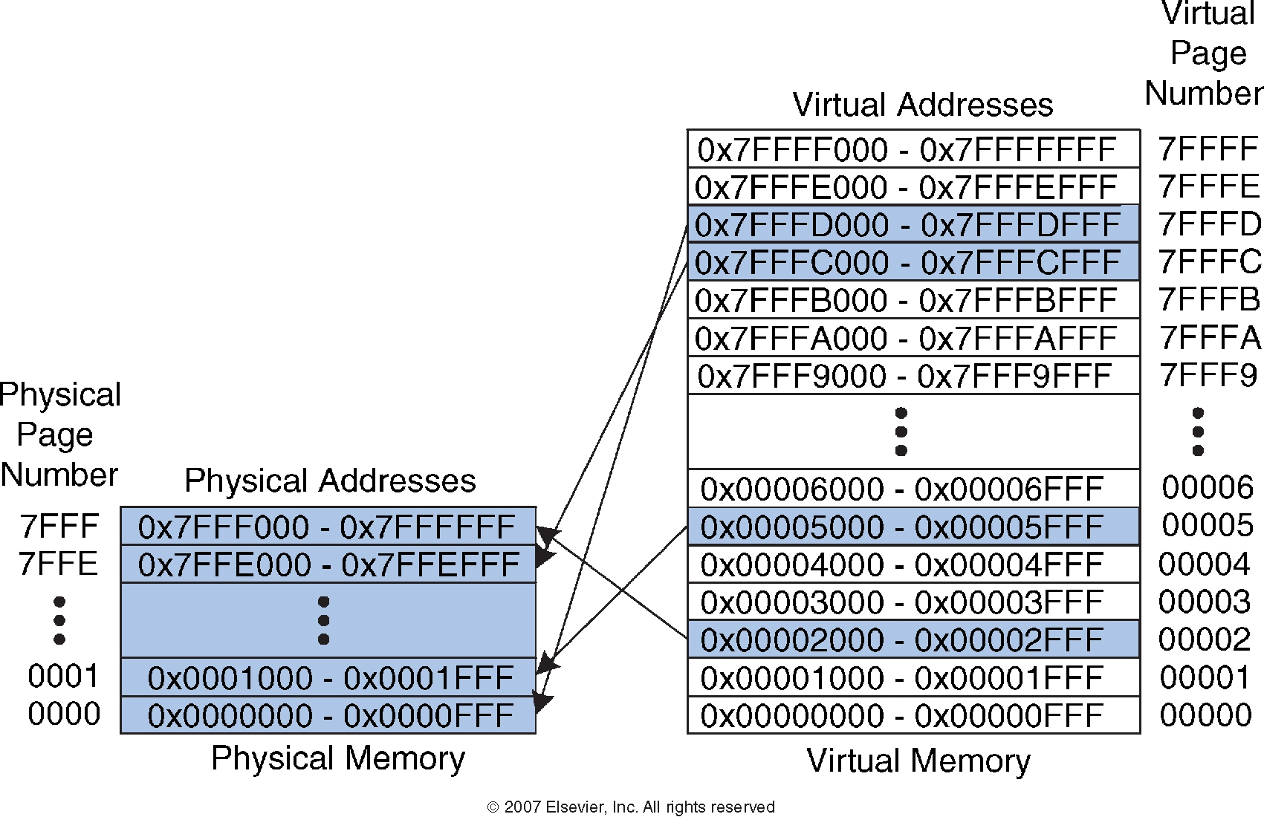
Recall: Virtual Memory Mapping Example

Slide 12
How Do We Translate Addresses?
Page table
Has entry for each virtual page
Each page table entry has:
Valid bit: whether the virtual page is located in physical memory (if not, it must be fetched from the hard disk)
Physical page number: where the virtual page is located in physical memory
(Replacement policy, dirty bits)

Slide 13
Page Table Address Translation Example
Page Table is Indexed
with the VPN
Page Table is located
at physical memory
address specified by
the PTBR (Page Table
Base Register)
Page offset bits
do not change
during translation
Page Table Provides
The PPN

Slide 14
Page Table Address Translation Example 1
What is the physical address of virtual address 0x5F20?
We first need to find the page table entry containing the translation for the corresponding VPN
Look up the PTE at the address
PTBR + VPN*PTE-size
14

Slide 15
Page Table Address Translation Example 1
What is the physical address of virtual address 0x5F20?
VPN = 5
Entry 5 in page table indicates VPN 5 is in physical page 1
Physical address is 0x1F20
15

Slide 16
Page Table Address Translation Example 2
What is the physical address of virtual address 0x73E0?
16

Slide 17
Page Table Address Translation Example 2
What is the physical address of virtual address 0x73E0?
VPN = 7
Entry 7 in page table is invalid, so the page is not in physical memory
The virtual page must be swapped into physical memory from disk
17

Slide 18
Issue: Page Table Size
64-bit
Suppose 64-bit VA and 40-bit PA, how large is the page table?
2⁵² entries x ~4 bytes ≈ 2⁵⁴ bytes
and that is for just one process!
and the process may not be using the entire VM space!
VPN
Page Offset
52-bit
12-bit
page
table
concat
PA
28-bit
40-bit

Slide 19
Page Table Challenges
Challenge 1: Page table is large
at least part of it needs to be located in physical memory
solution: multi-level (hierarchical) page tables
Challenge 2: Each instruction fetch or load/store requires at least two memory accesses:
1. one for address translation (page table read)
2. one to access data with the physical address (after translation)
Two memory accesses to service an instruction fetch or load/store greatly degrades execution time
Unless we are clever… → speed up the translation…

Slide 20
Translation Lookaside Buffer (TLB)
Idea: Cache the page table entries (PTEs) in a hardware structure in the processor to speed up address translation
Translation lookaside buffer (TLB)
Small cache of most recently used translations (PTEs)
Reduces number of memory accesses required for most instruction fetches and loads/stores to only one

Slide 21
Translation Lookaside Buffer (TLB)
Page table accesses have a lot of temporal locality
Data accesses have temporal and spatial locality
Large page size (say 4KB, 8KB, or even 1-2GB)
Consecutive instructions and loads/stores are likely to access same page
TLB
Small: accessed in ~ 1 cycle
Typically 16 - 512 entries
High associativity
> 95-99 % hit rates typical (depends on workload)
Reduces number of memory accesses for most instruction fetches and loads/stores to only one

Slide 22
Example Two-Entry TLB

Slide 23
Virtual Memory Support and Examples

Slide 24
Supporting Virtual Memory
Virtual memory requires both HW+SW support
Page Table is in memory
Can be cached in special hardware structures called Translation Lookaside Buffers (TLBs)
The hardware component is called the MMU (memory management unit)
Includes Page Table Base Register(s), TLBs, page walkers
It is the job of the software to leverage the MMU to
Populate page tables, decide what to replace in physical memory
Change the Page Table Register on context switch (to use the running thread’s page table)
Handle page faults and ensure correct mapping

Slide 25
Address Translation
How to obtain the physical address from a virtual address?
Page size specified by the ISA
VAX: 512 bytes
Today: 4KB, 8KB, 2GB, … (small and large pages mixed together)
Trade-offs? (remember cache lectures)
Page Table contains an entry for each virtual page
Called Page Table Entry (PTE)
What is in a PTE?

Slide 26
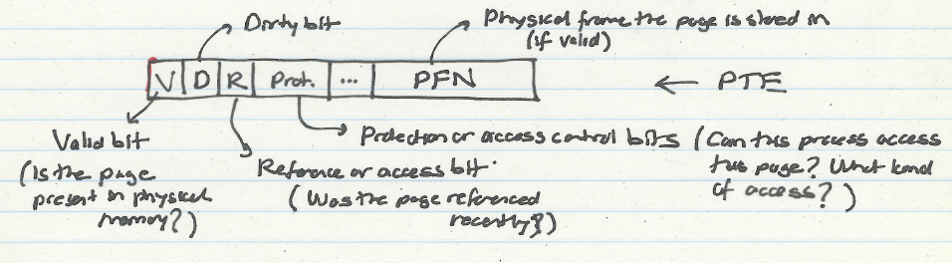
What Is in a Page Table Entry (PTE)?
Page table is the “tag store” for the physical memory data store
A mapping table between virtual memory and physical memory
PTE is the “tag store entry” for a virtual page in memory
Need a valid bit → to indicate validity/presence in physical memory
Need tag bits (PFN) → to support translation
Need bits to support replacement
Need a dirty bit to support “write back caching”
Need protection bits to enable access control and protection

Slide 27
Address Translation (I)
Parameters
P = 2^{p} = page size (bytes).
N = 2^{n} = Virtual-address limit
M = 2^{m} = Physical-address limit
n–1
p
p–1
0
virtual page number
page offset
virtual address
address translation
m–1
p
p–1
0
physical frame number
page offset
physical address
Page offset bits don’t change as a result of translation

Slide 28
Address Translation (II)
Separate (set of) page table(s) per process
VPN forms index into page table (points to a page table entry)
Page Table Entry (PTE) provides information about page
page table
base register
(per process)
virtual address
0
n–1
p
p–1
virtual page number (VPN)
page offset
valid
access
physical frame number (PFN)
VPN acts as
table index
if valid=0
then page
not in memory (page fault)
m–1
p
p–1
0
physical frame number (PFN)
page offset
physical address

Slide 29
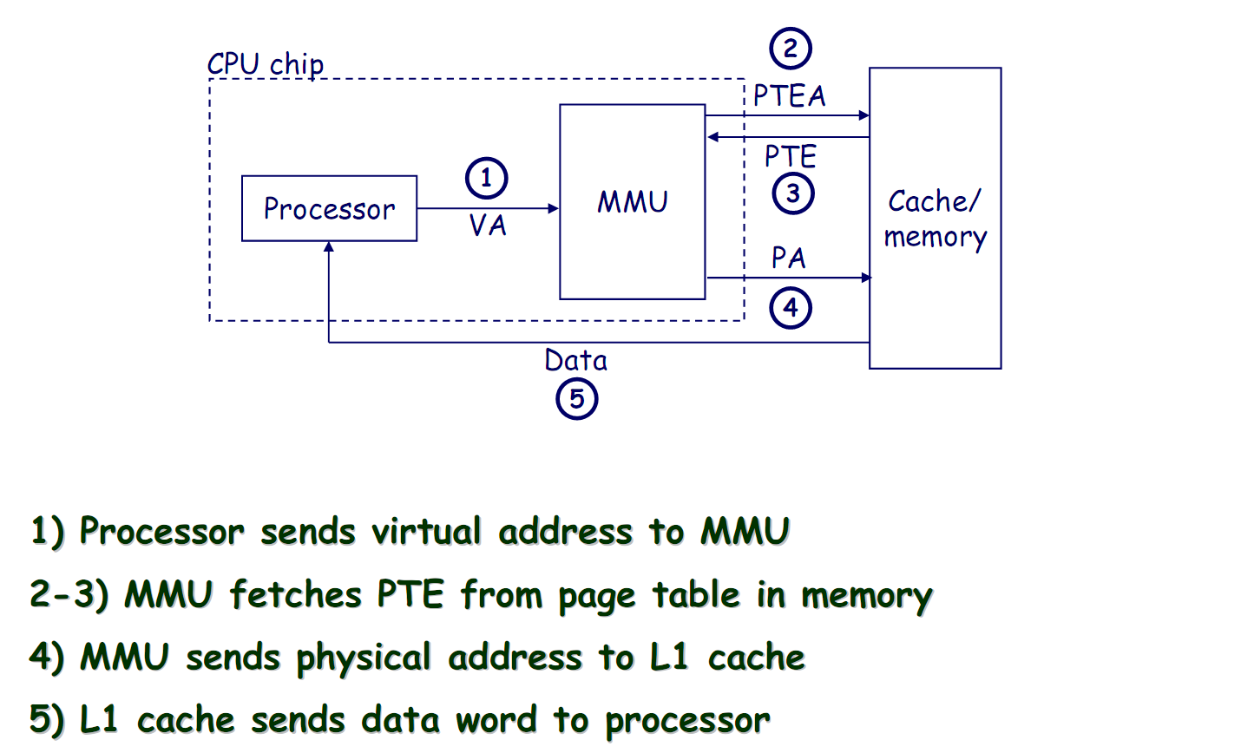
Address Translation: Page Hit

Slide 30
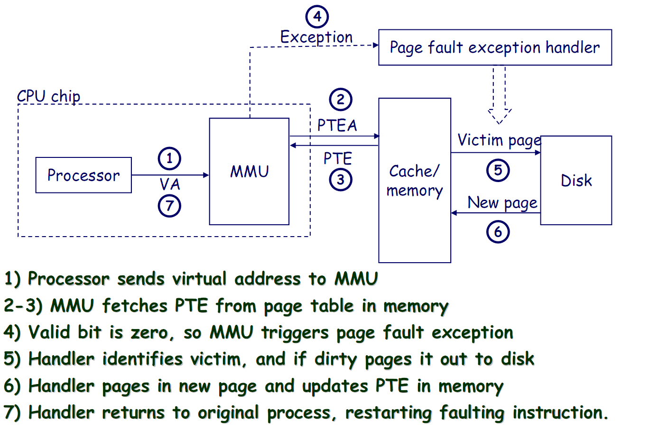
Address Translation: Page Fault

Slide 31
Page Fault (“A Miss in Physical Memory”)
If a page is not in physical memory but disk
Page table entry indicates virtual page not in memory
Access to such a page triggers a page fault exception
OS trap handler invoked to move data from disk into memory
Other processes can continue executing
OS has full control over placement
Before fault
After fault
Memory
Memory
Page Table
Virtual
Addresses
Physical
Addresses
Page Table
Virtual
Addresses
Physical
Addresses
CPU
CPU
Disk
Disk

Slide 32
Servicing a Page Fault
(1) Processor signals controller
Read block of length P starting at disk address X and store starting at memory address Y
(2) Read occurs
Direct Memory Access (DMA)
Under control of I/O controller
(3) Controller signals completion
Interrupt processor
OS resumes suspended process
(1) Initiate Block Read
Processor
Reg
(3) Read Done
Cache
Memory-I/O bus
(2) DMA Transfer
I/O
controller
Memory
Disk
Disk

Slide 33
Page Replacement Algorithms
If physical memory is full (i.e., list of free physical pages is empty), which physical frame to replace on a page fault?
Is True LRU feasible?
4GB memory, 4KB pages, how many possibilities of ordering?
Modern systems use approximations of LRU
E.g., the CLOCK algorithm
And, more sophisticated algorithms to take into account “frequency” of use
E.g., the ARC algorithm
Megiddo and Modha, “ARC: A Self-Tuning, Low Overhead Replacement Cache,” FAST 2003.

Slide 34
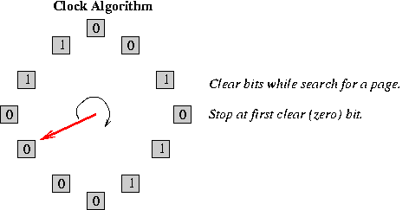
CLOCK Page Replacement Algorithm
Keep a circular list of physical frames in memory (OS does)
Keep a pointer (hand) to the last-examined frame in the list
When a page is accessed, set the R bit in the PTE
When a frame needs to be replaced, replace the first frame that has the reference (R) bit not set, traversing the circular list starting from the pointer (hand) clockwise
During traversal, clear the R bits of examined frames
Set the hand pointer to the next frame in the list

Slide 35
Cache versus Page Replacement
Physical memory (DRAM) is a cache for disk
Managed by system software via the virtual memory subsystem
Page replacement is similar to cache replacement
Page table is the “tag store” for physical memory data store
What is the difference?
Required speed of access to cache vs. physical memory
Number of blocks in a cache vs. physical memory
“Tolerable” amount of time to find a replacement candidate (disk versus memory access latency)
Role of hardware versus software

Slide 36
Memory Protection

Slide 37
Memory Protection
Multiple programs (processes) run at once
Each process has its own page table
Each process can use entire virtual address space without worrying about where other programs are
A process can only access physical pages mapped in its page table – cannot overwrite memory of another process
Provides protection and isolation between processes
Enables access control mechanisms per page

Slide 38
Page Table is Per Process
Each process has its own virtual address space
Full address space for each program
Simplifies memory allocation, sharing, linking and loading.
0
Physical Address
Space (DRAM)
Virtual Address Space for Process 1:
0
Address Translation
VP 1
PP 2
VP 2
...
N-1
(e.g., read/only library code)
PP 7
Virtual Address Space for Process 2:
0
VP 1
VP 2
PP 10
...
N-1
M-1

Slide 39
Access Protection/Control via Virtual Memory

Slide 40
Page-Level Access Control (Protection)
Not every process is allowed to access every page
E.g., may need supervisor level privilege to access system pages
Idea: Store access control information on a page basis in the process’s page table
Enforce access control at the same time as translation
→ Virtual memory system serves two functions today
Address translation (for illusion of large physical memory)
Access control (protection)

Slide 41
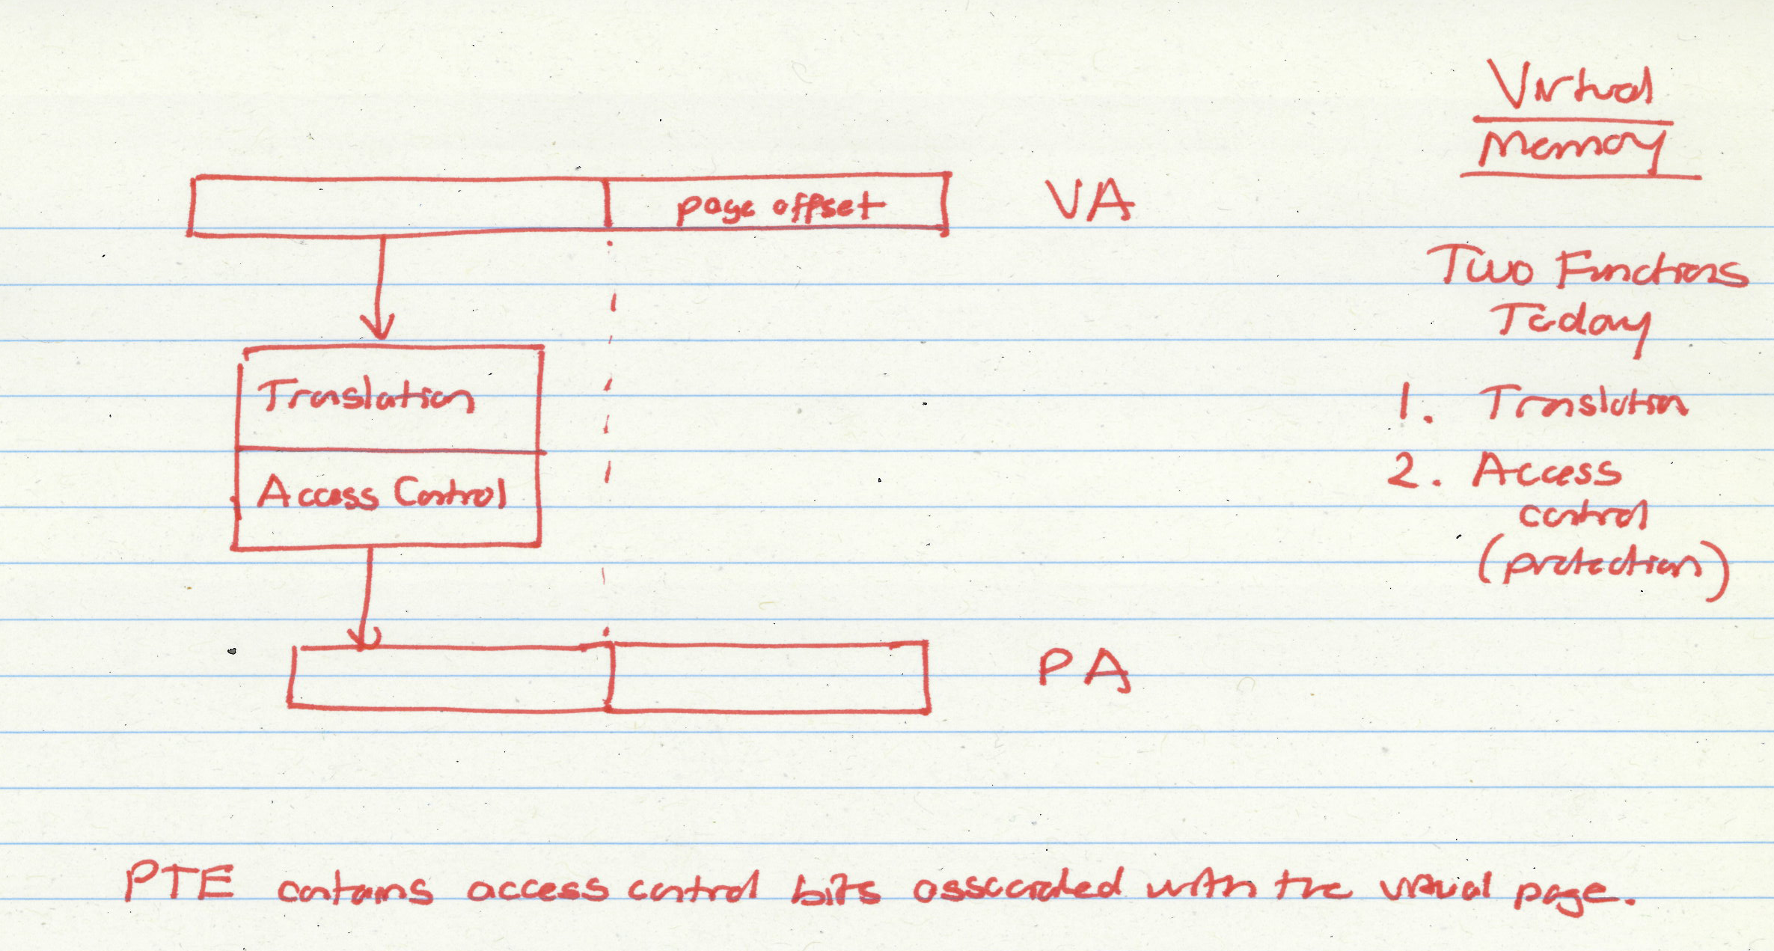
Two Functions of Virtual Memory

Slide 42
VM as a Tool for Memory Access Protection
Extend Page Table Entries (PTEs) with permission bits
Check bits on each access and during a page fault
If violated, generate exception (Access Protection exception)
Page Tables
Memory
Read?
Write?
Physical Addr
PP 0
VP 0:
Yes
No
PP 6
Process i:
PP 2
VP 1:
Yes
Yes
PP 4
VP 2:
No
No
XXXXXXX
PP 4
•
•
•
•
•
•
•
•
•
PP 6
Read?
Write?
Physical Addr
PP 8
VP 0:
Yes
Yes
PP 6
PP 10
Process j:
VP 1:
Yes
No
PP 9
PP 12
VP 2:
No
No
XXXXXXX
•
•
•
•
•
•
•
•
•
•
•
•

Slide 43
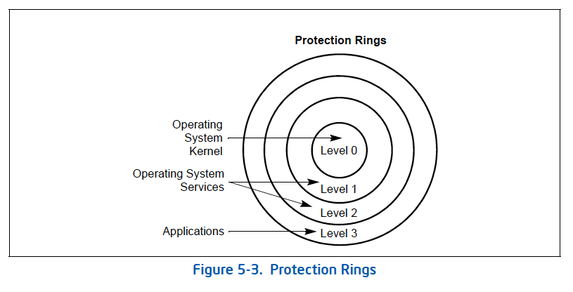
Privilege Levels in x86

Slide 44
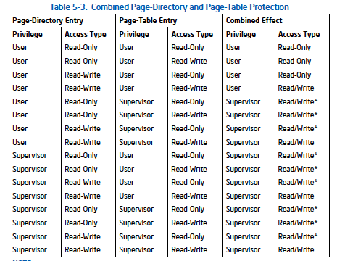
Page Level Protection in x86

Slide 45
Food for Thought: What If?
Your hardware is unreliable and someone can flip the access protection bits
such that a user-level program can gain supervisor-level access (i.e., access to all data on the system)
by flipping the access control bit from user to supervisor!
Can this happen?

Slide 46
Remember RowHammer?
One can
predictably induce errors
in most DRAM memory chips

Slide 47

Remember RowHammer?
DRAM Row Hammer (or, DRAM Disturbance Errors)
How a simple hardware failure mechanism can create a widespread system security vulnerability

Slide 48
Modern DRAM is Prone to Disturbance Errors
Row of Cells
Wordline
Row
Victim Row
Row
Hammered Row
V_{LOW}
Opened
V_{HIGH}
Closed
Row
Victim Row
Row
Repeatedly reading a row enough times (before memory gets refreshed) induces disturbance errors in adjacent rows in most real DRAM chips you can buy today
Flipping Bits in Memory Without Accessing Them: An Experimental Study of DRAM Disturbance Errors, (Kim et al., ISCA 2014)

Slide 49
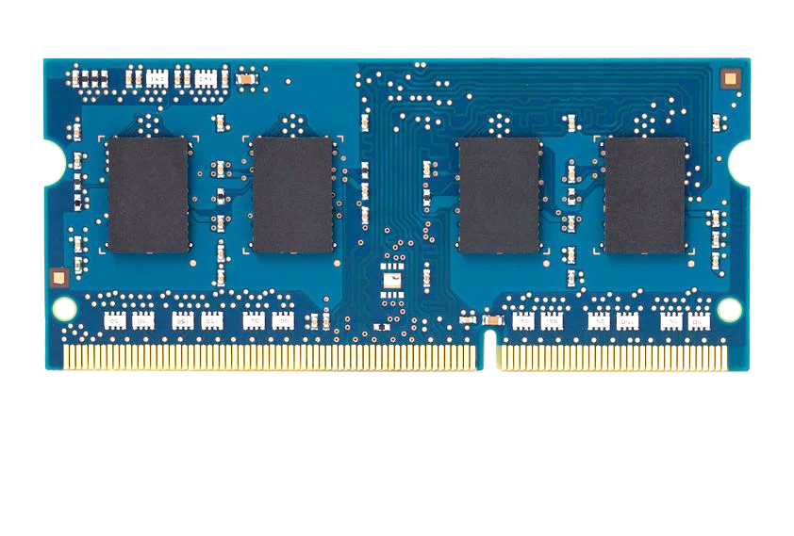
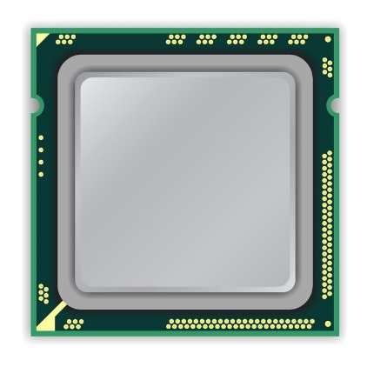
A Simple Program Can Induce Many Errors
CPU
DRAM Module
loop:
mov (X), %eax
mov (Y), %ebx
clflush (X)
clflush (Y)
mfence
jmp loop
X
Y
Download from: https://github.com/CMU-SAFARI/rowhammer
Notes:
We demonstrate the errors on multiple x86 systems. Shown to the bottom-left is a “disturbance kernel”. When executed, it forces two rows to be opened and closed one after the other – over and over again. Consequently, it induces many errors in the module.

Slide 50
A Simple Program Can Induce Many Errors
CPU
DRAM Module
Avoid cache hits
Flush X from cache
Avoid row hits to X
Read Y in another row
X
Y
Download from: https://github.com/CMU-SAFARI/rowhammer
Notes:
We demonstrate the errors on multiple x86 systems. Shown to the bottom-left is a “disturbance kernel”. When executed, it forces two rows to be opened and closed one after the other – over and over again. Consequently, it induces many errors in the module.

Slide 51
A Simple Program Can Induce Many Errors
CPU
DRAM Module
loop:
mov (X), %eax
mov (Y), %ebx
clflush (X)
clflush (Y)
mfence
jmp loop
X
Y
Download from: https://github.com/CMU-SAFARI/rowhammer
Notes:
We demonstrate the errors on multiple x86 systems. Shown to the bottom-left is a “disturbance kernel”. When executed, it forces two rows to be opened and closed one after the other – over and over again. Consequently, it induces many errors in the module.

Slide 52
A Simple Program Can Induce Many Errors
CPU
DRAM Module
loop:
mov (X), %eax
mov (Y), %ebx
clflush (X)
clflush (Y)
mfence
jmp loop
X
Y
Download from: https://github.com/CMU-SAFARI/rowhammer
Notes:
We demonstrate the errors on multiple x86 systems. Shown to the bottom-left is a “disturbance kernel”. When executed, it forces two rows to be opened and closed one after the other – over and over again. Consequently, it induces many errors in the module.

Slide 53
A Simple Program Can Induce Many Errors
CPU
DRAM Module
loop:
mov (X), %eax
mov (Y), %ebx
clflush (X)
clflush (Y)
mfence
jmp loop
X
Y
Download from: https://github.com/CMU-SAFARI/rowhammer
Notes:
We demonstrate the errors on multiple x86 systems. Shown to the bottom-left is a “disturbance kernel”. When executed, it forces two rows to be opened and closed one after the other – over and over again. Consequently, it induces many errors in the module.

Slide 54
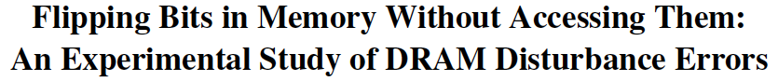
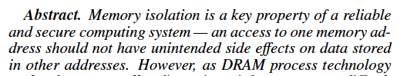
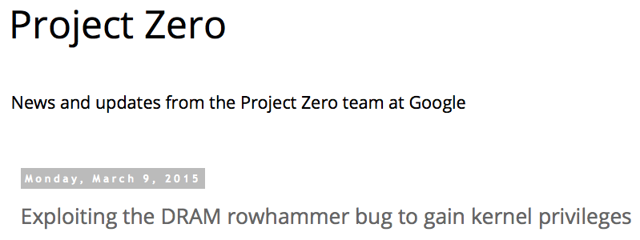
One Can Take Over an Otherwise-Secure System
Flipping Bits in Memory Without Accessing Them: An Experimental Study of DRAM Disturbance Errors (Kim et al., ISCA 2014)
Exploiting the DRAM rowhammer bug to gain kernel privileges (Seaborn, 2015)

Slide 55
RowHammer Security Attack Example
“Rowhammer” is a problem with some recent DRAM devices in which repeatedly accessing a row of memory can cause bit flips in adjacent rows (Kim et al., ISCA 2014).
Flipping Bits in Memory Without Accessing Them: An Experimental Study of DRAM Disturbance Errors (Kim et al., ISCA 2014)
We tested a selection of laptops and found that a subset of them exhibited the problem.
We built two working privilege escalation exploits that use this effect.
Exploiting the DRAM rowhammer bug to gain kernel privileges (Seaborn+, 2015)
One exploit uses rowhammer-induced bit flips to gain kernel privileges on x86-64 Linux when run as an unprivileged userland process.
When run on a machine vulnerable to the rowhammer problem, the process was able to induce bit flips in page table entries (PTEs).
It was able to use this to gain write access to its own page table, and hence gain read-write access to all of physical memory.
Exploiting the DRAM rowhammer bug to gain kernel privileges (Seaborn & Dullien, 2015)

Slide 56

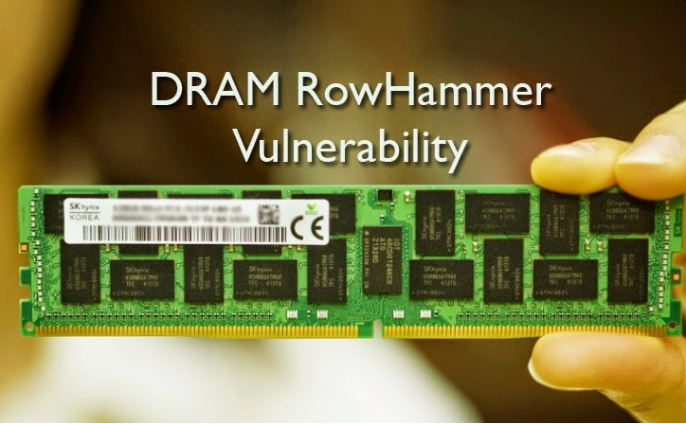
Security Implications
Notes:
Picture from the article:
http://thehackernews.com/2015/03/dram-rowhammer-vulnerability.html

Slide 57
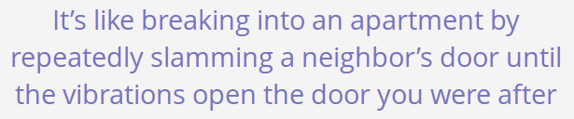
Security Implications
Notes:
Picture from the article:
http://thehackernews.com/2015/03/dram-rowhammer-vulnerability.html

Slide 58

More Security Implications (I)
“We can gain unrestricted access to systems of website visitors.”
Rowhammer.js: A Remote Software-Induced Fault Attack in JavaScript (DIMVA’16)
Source: https://lab.dsst.io/32c3-slides/7197.html

Slide 59

More Security Implications (II)
“Can gain control of a smart phone deterministically”
Drammer: Deterministic Rowhammer Attacks on Mobile Platforms, CCS’16
Source: https://fossbytes.com/drammer-rowhammer-attack-android-root-devices/

Slide 60
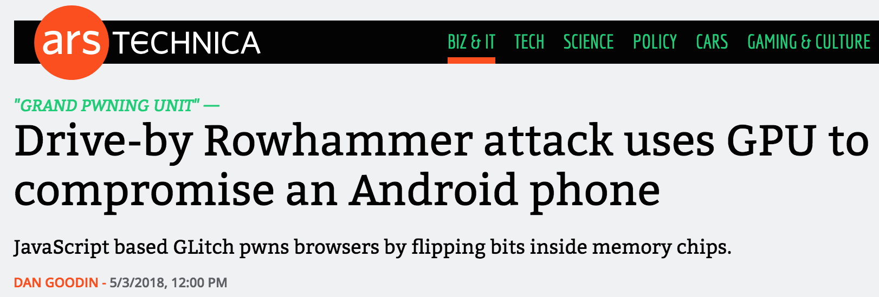

More Security Implications (III)
Using an integrated GPU in a mobile system to remotely escalate privilege via the WebGL interface

Slide 61
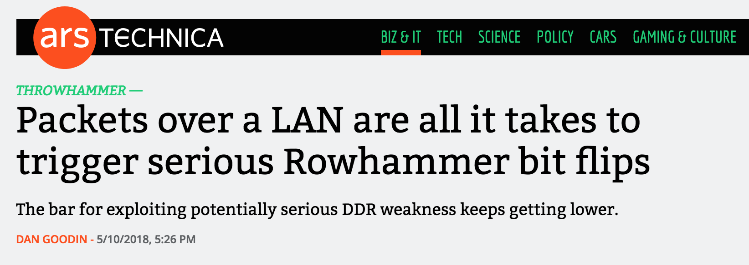
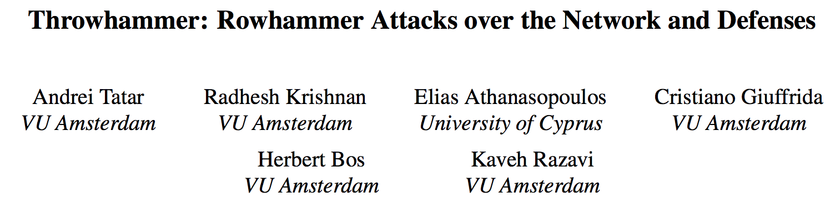
More Security Implications (IV)
Rowhammer over RDMA (I)

Slide 62


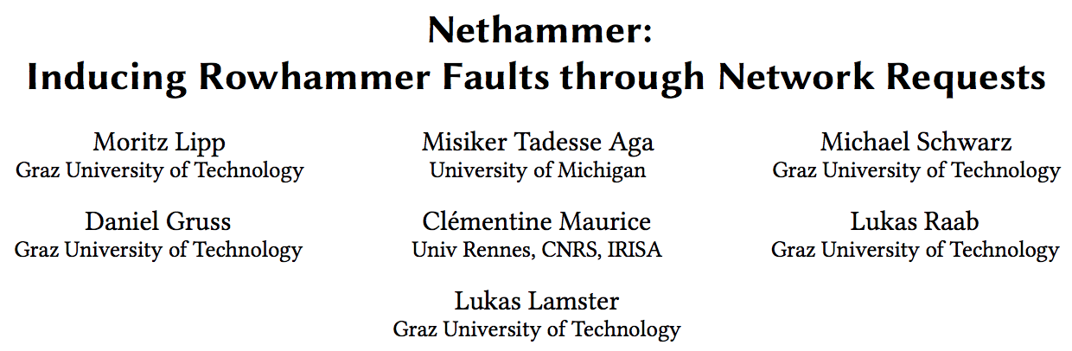
More Security Implications (V)
Rowhammer over RDMA (II)

Slide 63
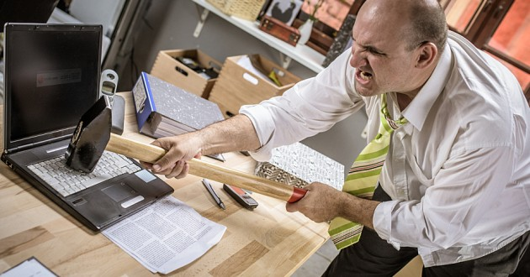
More Security Implications?

Slide 64
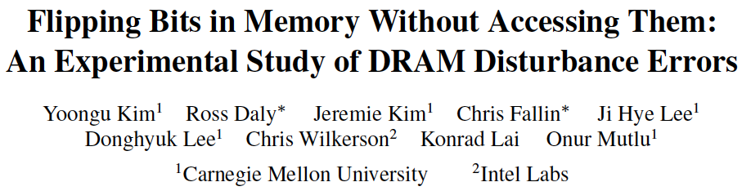
Curious? First RowHammer Paper
Yoongu Kim, Ross Daly, Jeremie Kim, Chris Fallin, Ji Hye Lee, Donghyuk Lee, Chris Wilkerson, Konrad Lai, and Onur Mutlu, "Flipping Bits in Memory Without Accessing Them: An Experimental Study of DRAM Disturbance Errors" Proceedings of the 41st International Symposium on Computer Architecture (ISCA), Minneapolis, MN, June 2014. [Slides (pptx) (pdf)] [Lightning Session Slides (pptx) (pdf)] [Source Code and Data]

Slide 65
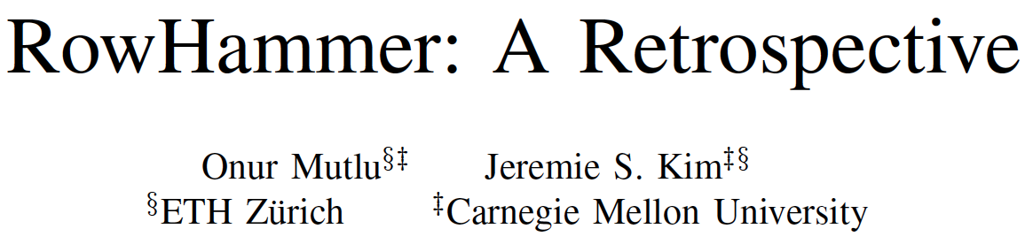
Curious? A RowHammer Retrospective
Onur Mutlu and Jeremie Kim, "RowHammer: A Retrospective" IEEE Transactions on Computer-Aided Design of Integrated Circuits and Systems (TCAD) Special Issue on Top Picks in Hardware and Embedded Security, 2019. [Preliminary arXiv version]

Slide 66
Takeaway and Food for Thought
If hardware is unreliable, higher-level security and protection mechanisms (as in virtual memory) may be compromised
The root of security and trust is at the very low levels…
in the hardware itself
RowHammer, Spectre, Meltdown are recent key examples…
What should we assume the hardware provides?
How do we keep hardware reliable?
How do we design secure hardware?
How do we design secure hardware with high performance, high energy efficiency, low cost, convenient programming?
Plenty of exciting and highly-relevant research questions

Slide 67
Some Issues in Virtual Memory

Slide 68
Three Major Issues
1. How large is the page table and how do we store and access it?
2. How can we speed up translation & access control check?
3. When do we do the translation in relation to cache access?
There are many other issues we will not cover in detail
What happens on a context switch?
How can you handle multiple page sizes?
…

Slide 69
Teaser: Virtual Memory Issue III
When do we do the address translation?
Before or after accessing the L1 cache?

Slide 70
Address Translation and Caching
When do we do the address translation?
Before or after accessing the L1 cache?
In other words, is the cache virtually addressed or physically addressed?
Virtual versus physical cache
What are the issues with a virtually addressed cache?
Synonym problem:
Two different virtual addresses can map to the same physical address → same physical address can be present in multiple locations in the cache → can lead to inconsistency in data

Slide 71
Cache-VM Interaction
CPU
CPU
CPU
TLB
VA
cache
PA
cache
tlb
VA
PA
cache
tlb
VA
PA
lower
hier.
lower
hier.
lower
hier.
physical cache
virtual (L1) cache
virtual-physical cache

Slide 72
Virtual Memory Summary

Slide 73
Virtual Memory Summary
Virtual memory gives the illusion of “infinite” capacity
A subset of virtual pages are located in physical memory
A page table maps virtual pages to physical pages – this is called address translation
A TLB speeds up address translation
Multi-level page tables keep the page table size in check
Using different page tables for different programs provides memory protection

Slide 74
Virtual Memory: Parting Thoughts
VM is one of the most successful examples of
architectural support for programmers
how to partition work between hardware and software
hardware/software cooperation
programmer/architect tradeoff
Going forward: How does virtual memory scale into the future? Three key trends:
Increasing, huge physical memory sizes
Hybrid physical memory systems (DRAM + NVM + …)
Many accelerators in the system addressing physical memory

Slide 75
Design of Digital Circuits Lecture 24: Virtual Memory II
Prof. Onur Mutlu
ETH Zurich
Spring 2020
28 May 2020

Slide 76
Some Issues in Virtual Memory

Slide 77
Three Major Issues
1. How large is the page table and how do we store and access it?
2. How can we speed up translation & access control check?
3. When do we do the translation in relation to cache access?
There are many other issues we will not cover in detail
What happens on a context switch?
How can you handle multiple page sizes?
…

Slide 78
Virtual Memory Issue I
How large is the page table?
Where do we store it?
In hardware?
In physical memory? (Where is the PTBR?)
In virtual memory? (Where is the PTBR?)
How can we store it efficiently without requiring physical memory that can store all page tables?
Idea: multi-level page tables
Only the first-level page table has to be in physical memory
Remaining levels are in virtual memory (but get cached in physical memory when accessed)

Slide 79
Issue: Page Table Size
64-bit
Suppose 64-bit VA and 40-bit PA, how large is the page table?
2⁵² entries x ~4 bytes ≈ 2⁵⁴ bytes
and that is for just one process!
and the process may not be using the entire VM space!
VPN
Page Offset
52-bit
12-bit
page
table
concat
PA
28-bit
40-bit

Slide 80
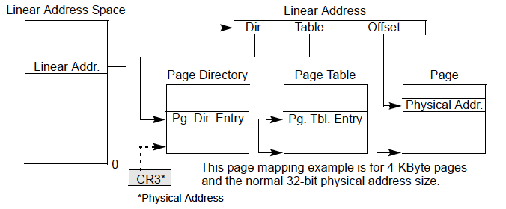
Solution: Multi-Level Page Tables
Example from the x86 architecture

Slide 81
Page Table Access
How do we access the Page Table?
Page Table Base Register (CR3 in x86)
Page Table Limit Register
If VPN is out of the bounds (exceeds PTLR) then the process did not allocate the virtual page → access control exception
Page Table Base Register is part of a process’s context
Just like PC, status registers, general purpose registers
Needs to be loaded when the process is context-switched in

Slide 82
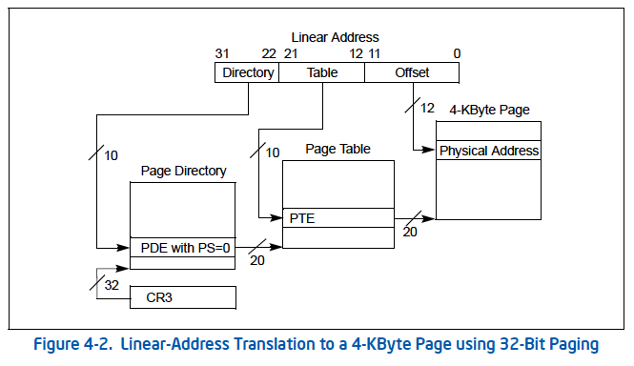
More on x86 Page Tables (I): Small Pages

Slide 83
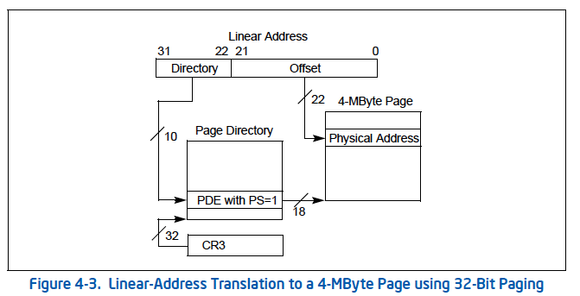
More on x86 Page Tables (II): Large Pages

Slide 84
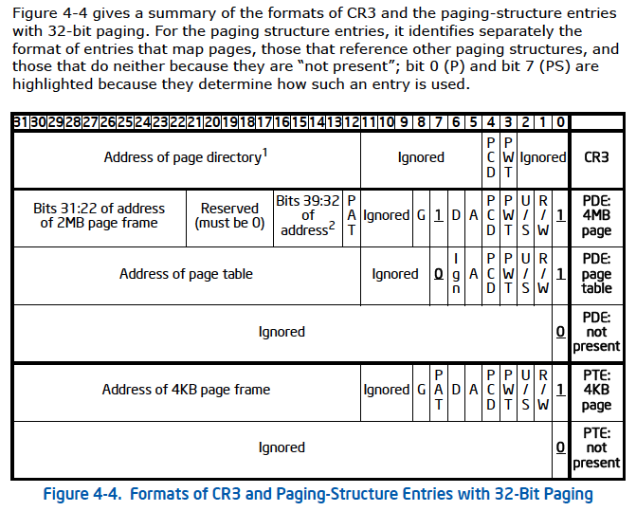
x86 Page Table Entries

Slide 85
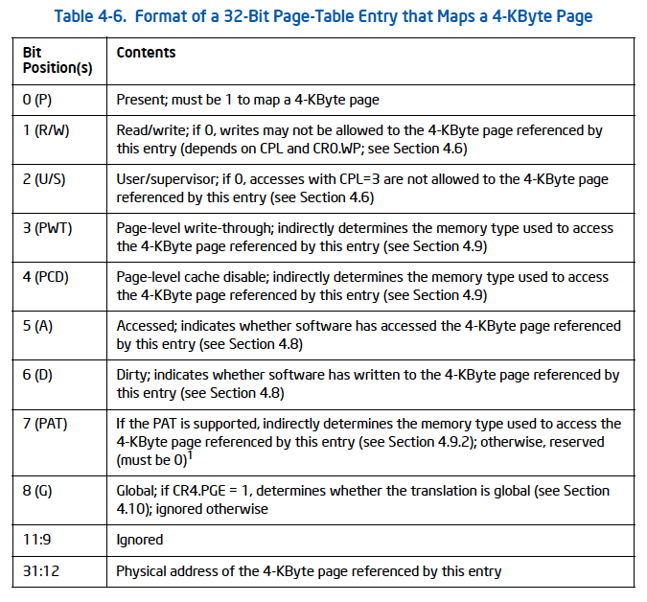
x86 PTE (4KB page)

Slide 86
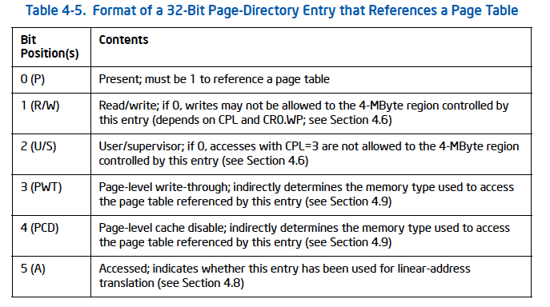
x86 Page Directory Entry (PDE)

Slide 87
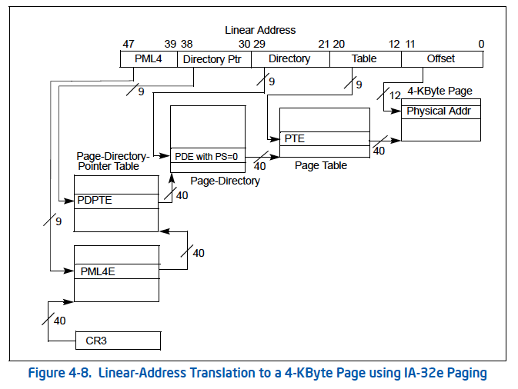
Four-level Paging in x86

Slide 88
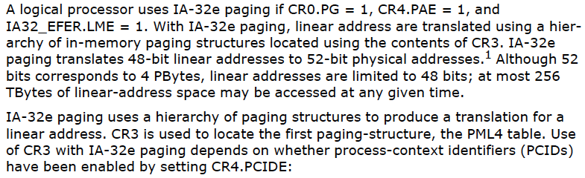
Four-level Paging and Extended Physical Address Space in x86

Slide 89
Virtual Memory Issue II
How fast is the address translation?
How can we make it fast?
Idea: Use a hardware structure that caches PTEs → Translation lookaside buffer
What should be done on a TLB miss?
What TLB entry to replace?
Who handles the TLB miss? HW vs. SW?
What should be done on a page fault?
What virtual page to replace from physical memory?
Who handles the page fault? HW vs. SW?

Slide 90
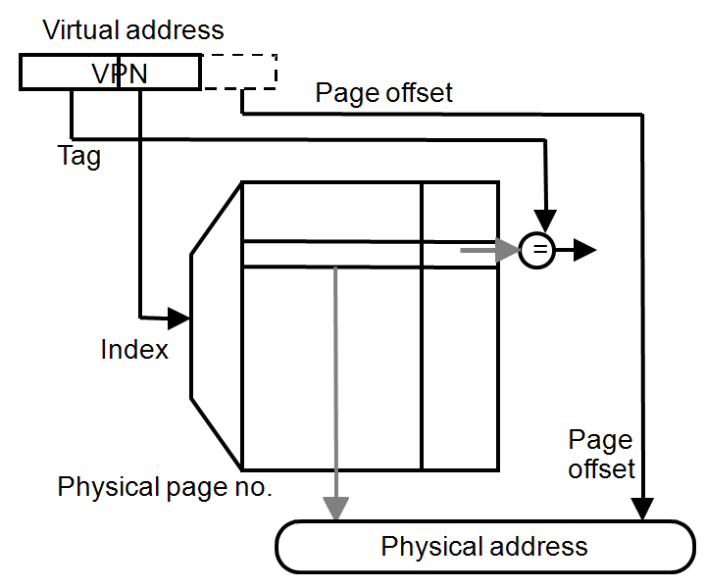
Speeding up Translation with a TLB
Essentially a cache of recent address translations
Avoids going to the page table on every reference
Index = lower bits of VPN
(virtual page #)
Tag = unused bits of VPN +
process ID
Data = a page-table entry
Status = valid, dirty
The usual cache design choices
(placement, replacement policy,
multi-level, etc.) apply here too.
Notes:
What should be the relative sizes of I-TLB and I-Cache

Slide 91
Handling TLB Misses
The TLB is small; it cannot hold all PTEs
Some translations will inevitably miss in the TLB
Must access memory to find the appropriate PTE
Called walking the page directory/table
Large performance penalty
Who handles TLB misses? Hardware or software?

Slide 92
Handling TLB Misses (II)
Approach #1. Hardware-Managed (e.g., x86)
The hardware does the page walk
The hardware fetches the PTE and inserts it into the TLB
If the TLB is full, the entry replaces another entry
Done transparently to system software
Approach #2. Software-Managed (e.g., MIPS)
The hardware raises an exception
The operating system does the page walk
The operating system fetches the PTE
The operating system inserts/evicts entries in the TLB

Slide 93
Handling TLB Misses (III)
Hardware-Managed TLB
Pro: No exception on TLB miss. Instruction just stalls
Pro: Independent instructions may continue
Pro: No extra instructions/data brought into caches.
Con: Page directory/table organization is etched into the system: OS has little flexibility in deciding these
Software-Managed TLB
Pro: The OS can define page table oganization
Pro: More sophisticated TLB replacement policies are possible
Con: Need to generate an exception → performance overhead due to pipeline flush, exception handler execution, extra instructions brought to caches

Slide 94
Virtual Memory Issue III
When do we do the address translation?
Before or after accessing the L1 cache?

Slide 95
Virtual Memory and Cache Interaction

Slide 96
Address Translation and Caching
When do we do the address translation?
Before or after accessing the L1 cache?
In other words, is the cache virtually addressed or physically addressed?
Virtual versus physical cache
What are the issues with a virtually addressed cache?
Synonym problem:
Two different virtual addresses can map to the same physical address → same physical address can be present in multiple locations in the cache → can lead to inconsistency in data

Slide 97
Homonyms and Synonyms
Homonym: Same VA can map to two different PAs
Why?
VA is in different processes
Synonym: Different VAs can map to the same PA
Why?
Different pages can share the same physical frame within or across processes
Reasons: shared libraries, shared data, copy-on-write pages within the same process, …
Do homonyms and synonyms create problems when we have a cache?
Is the cache virtually or physically addressed?

Slide 98
Cache-VM Interaction
CPU
CPU
CPU
TLB
VA
cache
PA
cache
tlb
VA
PA
cache
tlb
VA
PA
lower
hier.
lower
hier.
lower
hier.
physical cache
virtual (L1) cache
virtual-physical cache

Slide 99
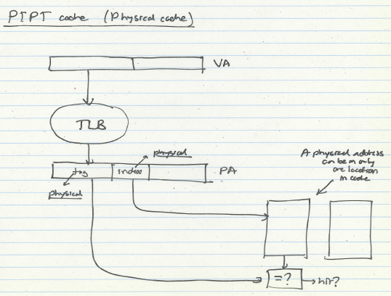
Physical Cache

Slide 100
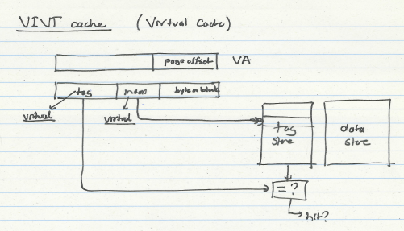
Virtual Cache

Slide 101
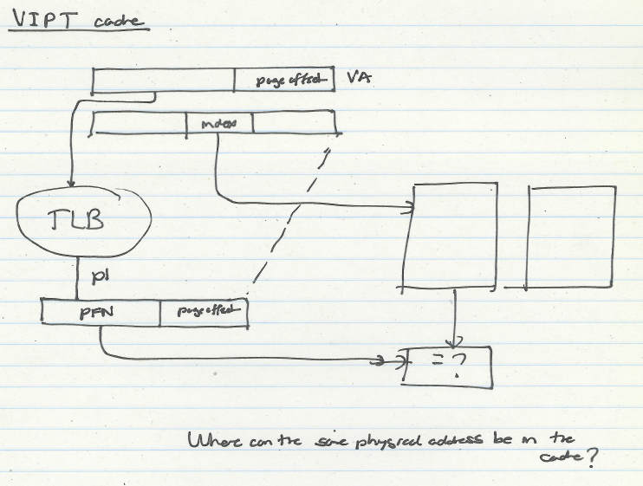
Virtual-Physical Cache

Slide 102
Virtually-Indexed Physically-Tagged
If C≤(page_size × associativity), the cache index bits come only from page offset (same in VA and PA)
If both cache and TLB are on chip
index both arrays concurrently using VA bits
check cache tag (physical) against TLB output at the end
VPN
Page Offset
Index
BiB
TLB
physical
cache
PPN
=
tag
data
TLB hit?
cache hit?

Slide 103
Virtually-Indexed Physically-Tagged
If C>(page_size × associativity), the cache index bits include VPN ⇒ Synonyms can cause problems
The same physical address can exist in two locations
Solutions?
VPN
Page Offset
Index
BiB
a
TLB
physical
cache
PPN
=
tag
data
TLB hit?
cache hit?

Slide 104
Some Solutions to the Synonym Problem
Limit cache size to (page size times associativity)
get index from page offset
On a write to a block, search all possible indices that can contain the same physical block, and update/invalidate
Used in Alpha 21264, MIPS R10K
Restrict page placement in OS
make sure index(VA) = index(PA)
Called page coloring
Used in many SPARC processors

Slide 105
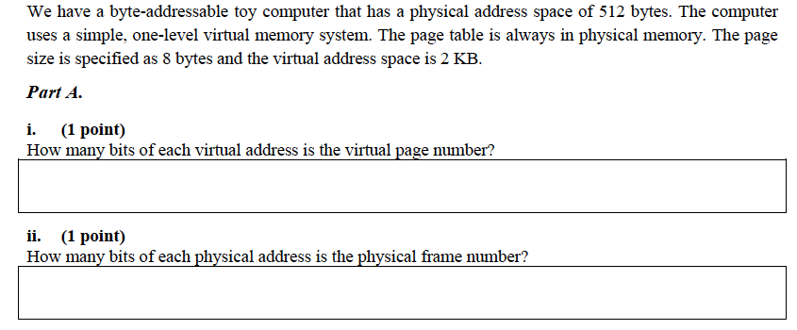
An Exercise (I)

Slide 106
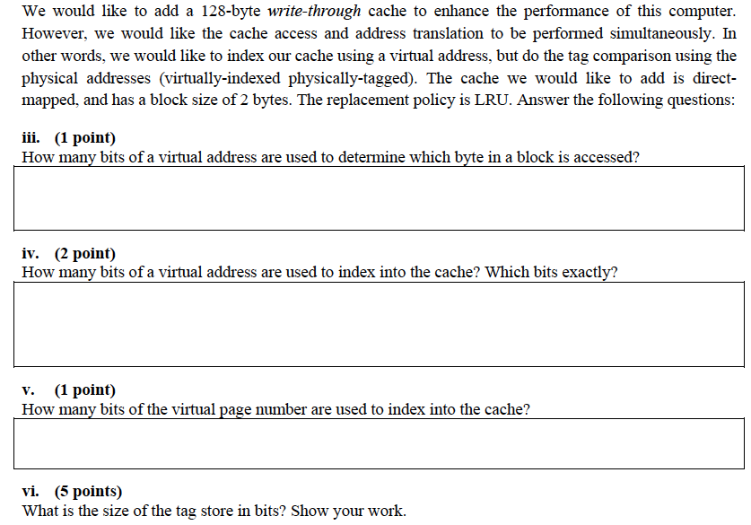
An Exercise (II)

Slide 107
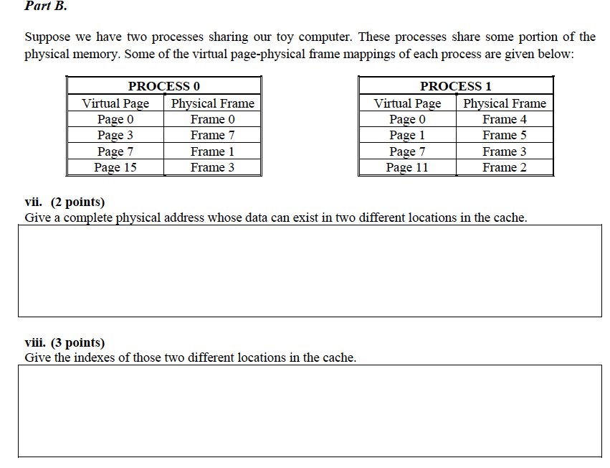

Slide 108
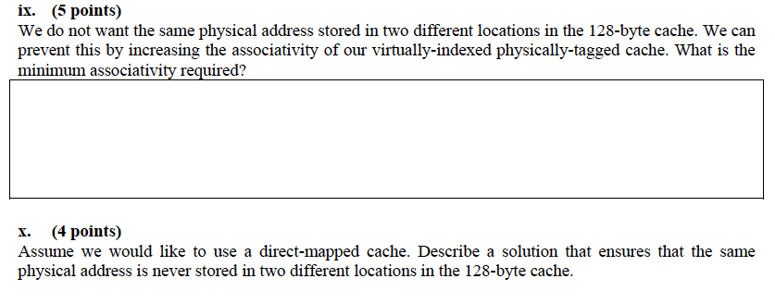
An Exercise (Concluded)

Slide 109
Some System Software Tasks for VM
Keeping track of which physical frames are free
Allocating free physical frames to virtual pages
Page replacement policy
When no physical frame is free, what should be removed?
Sharing pages between processes
Copy-on-write optimization
Page-flip optimization

